Slide 1
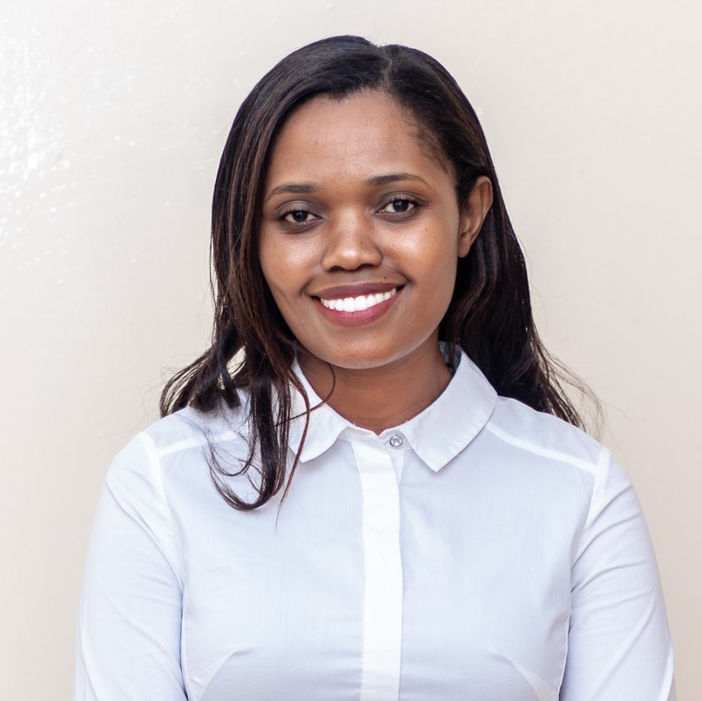
My experience with the Rotary Peace Fellowship
By Chimwemwe Kumwenda
Notes:
Hello Rotarians. As already mentioned, my name is Chimwemwe and I’d like to thank you for the opportunity to share my exciting journey during the Rotary Peace Fellowship.
Before I share my experience, let me 1st give you a brief background of my work and what motivated me to apply for the fellowship

Slide 2
Chimwemwe
Notes:
My name Chimwemwe means Joy. So you can call me Joy or Chim ☺

Slide 3
Notes:
I was born and grew up in Malawi, my mother’s home country
Malawi is located in the southeastern part of Africa as shown in the map. It is approximately the size of Pennsylvania, but has a population of 8.5million more
My dad is from Rwanda. Some of you may be aware that Rwanda suffered 100 days of genocide in 1994 where 800,000 people were slaughtered by Ethnic Hutu extremists
However, my father left his country during the 1st ethnic attacks in the late 1960’s and made Malawi his new home
During the 1994 genocide, I was 9 and we used to listen to the radio a lot to get updates regarding the genocide
I imagined the many innocent children my age who were forced to flee their homes. I even imagine them being wounded and needing treatment
This motivated me to become a medical doctor and treat war victims

Slide 4
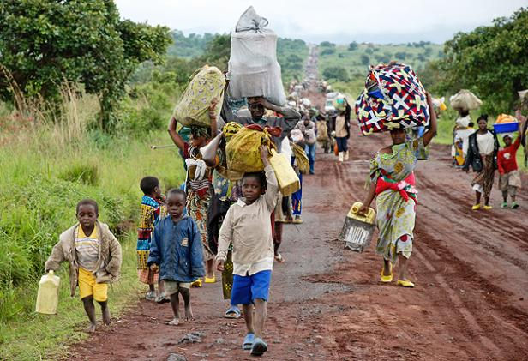
https://greatlakesvoice.com/over-4500-congolese-refugees-flee-into-uganda/
Notes:
- I imagined such suffering among children

Slide 5
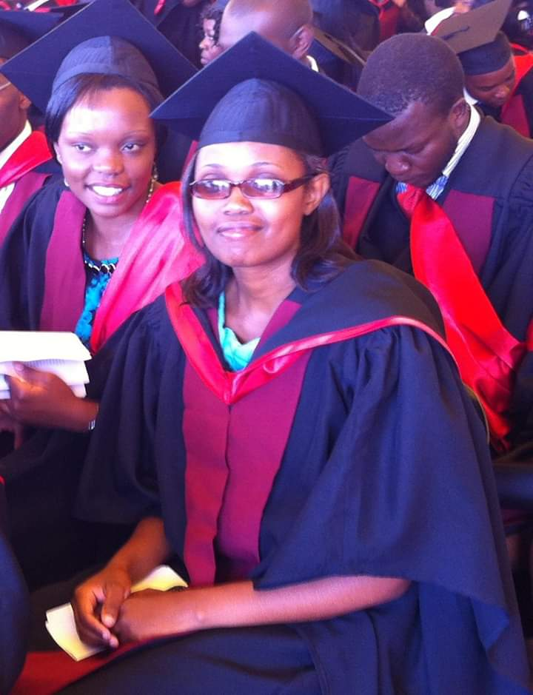
Notes:
- 9 years ago, I graduated as a medical doctor

Slide 6
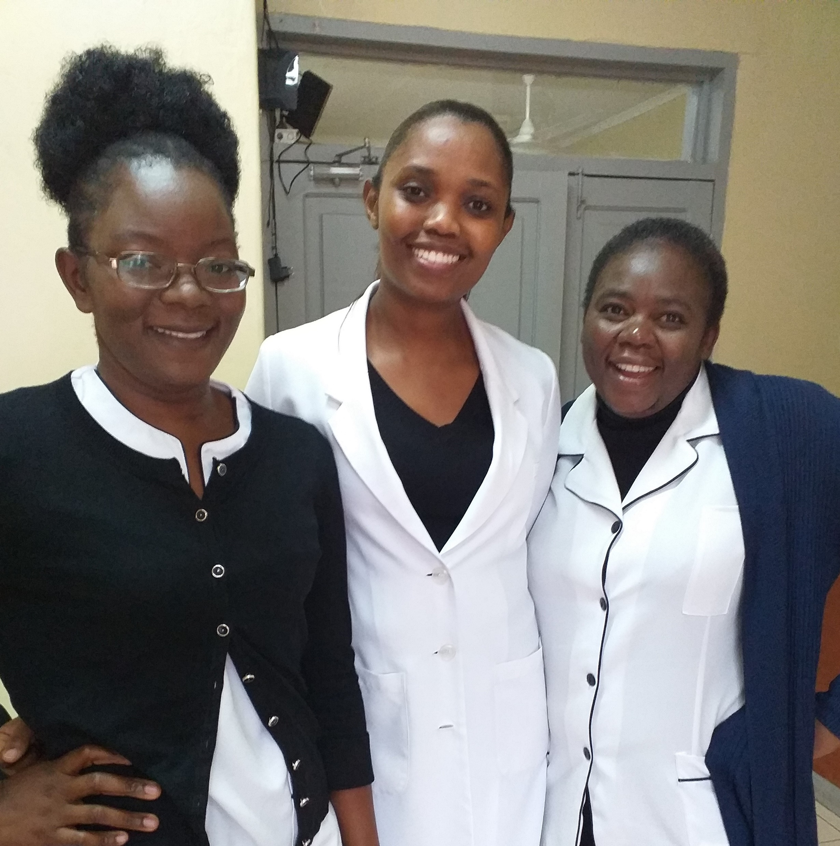
Notes:
I started working at a private hospital located in the heart of the capital city.
However, I still wanted to follow what drove me to become a medical doctor, i.e serve the refugee population
I then started volunteering at Dzaleka Refugee Camp, Malawi’s largest refugee camp

Slide 7
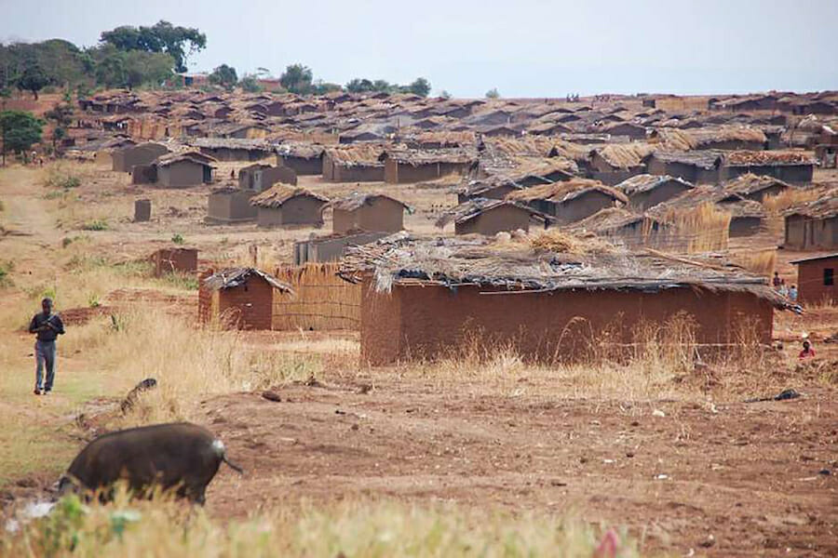
Notes:
- Part of the refugee camp

Slide 8
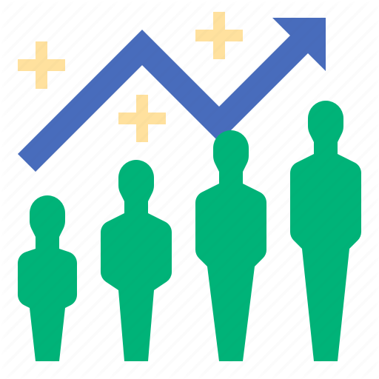
Dzaleka Refugee Camp
Originally built for 10,000 refugees
Now has a population of 40,000 refugees
300% increase
Congestion in the camp

Slide 9
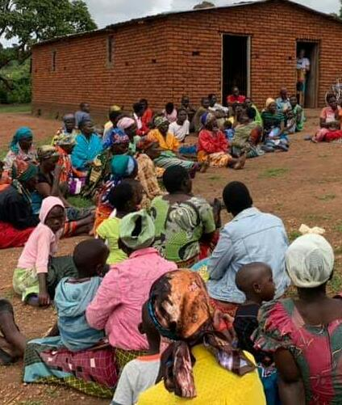
Notes:
Due to the congestion, there is a strain on the available resources, especially medical personnel at the camp’s clinic
This resulted in very long queues of patients waiting to be assisted and I was moved to volunteer and help at the clinic

Slide 10
Notes:
Me attending to a child with signs of pneumonia
Apart from a shortage of health personnel, there was also a shortage of drugs at the camp’s clinic.
I found it heartbreaking to send some children home without the required medication.
All I could do was tell them to but from the surrounding drug stores but most of them couldn’t afford.

Slide 11
Notes:
- I had to approach the business community to ask for donations of medical supplies

Slide 12
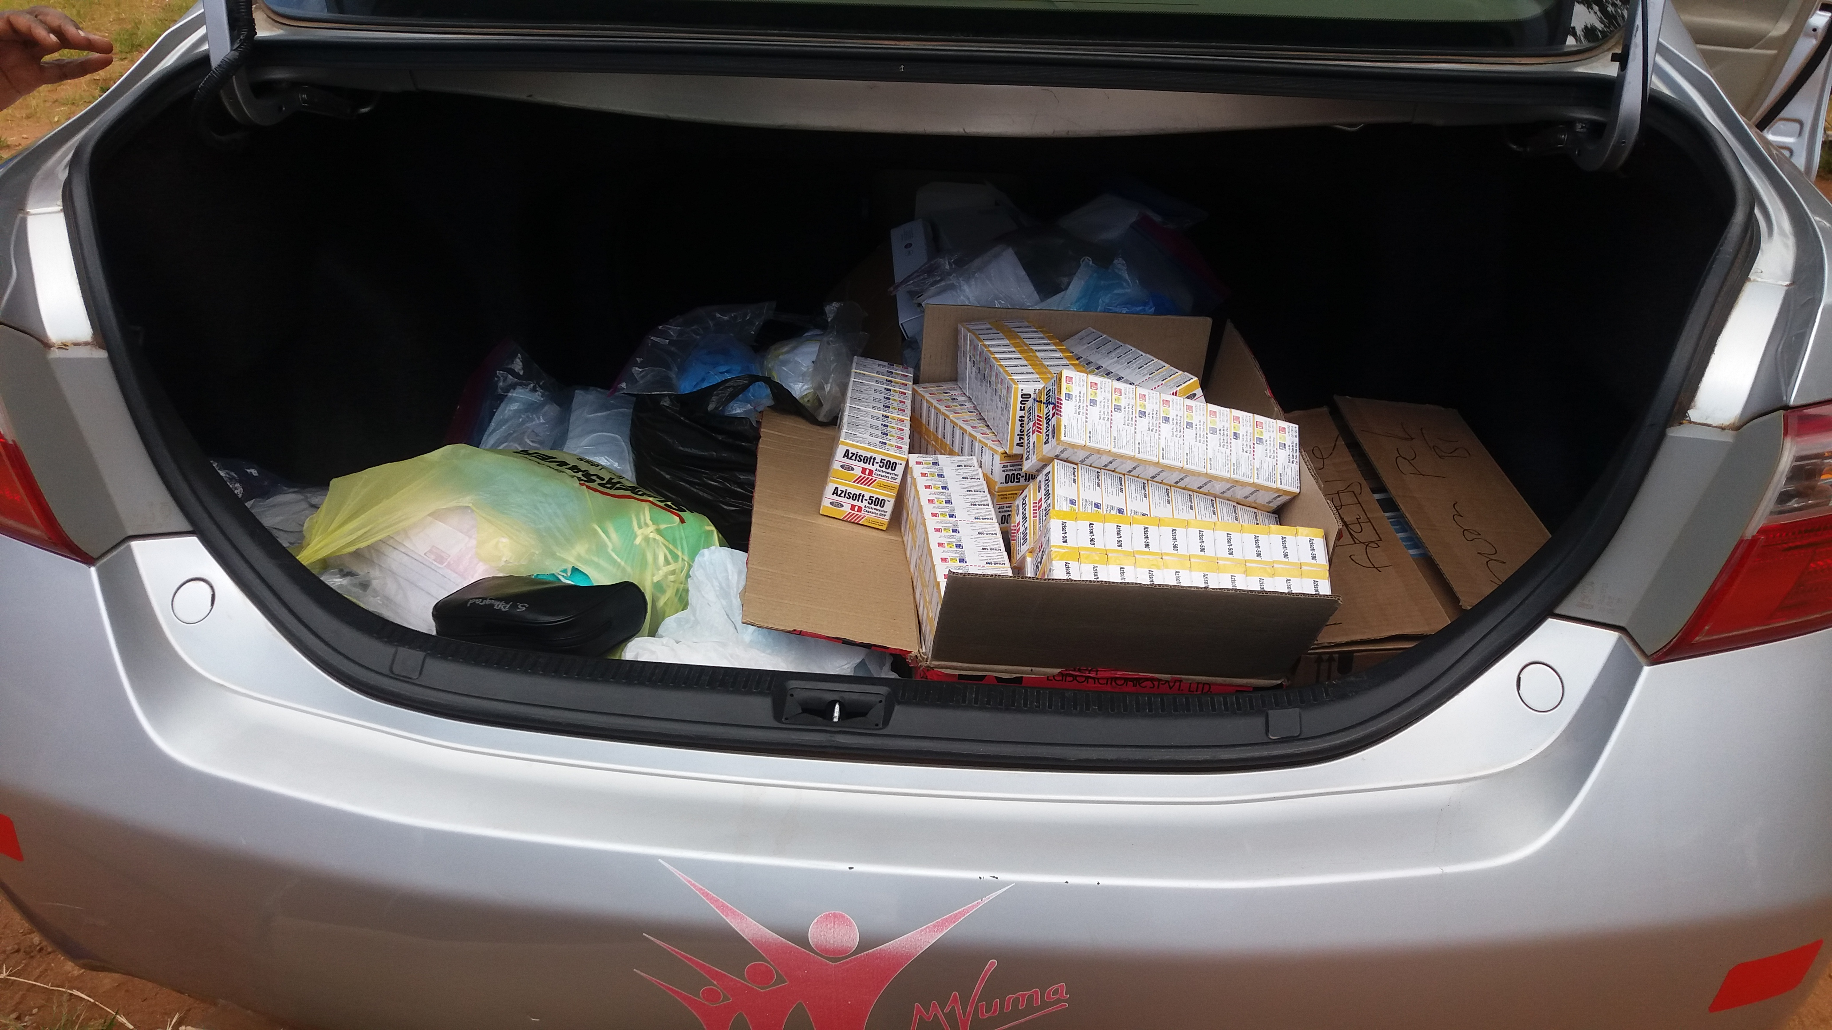
Notes:
However, as you can see, these donations were far from meeting even half of the needs
The most heartbreaking part was that the people I attended to at the hospital I worked at could afford and have access to any type of medication they needed and yet this refugee population that was already facing the hardships of being displaced due to war could not receive the care they needed.

Slide 13
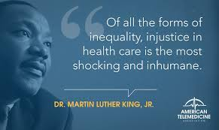
Notes:
- This brings me to this quote by Dr Martin Luther King…

Slide 14
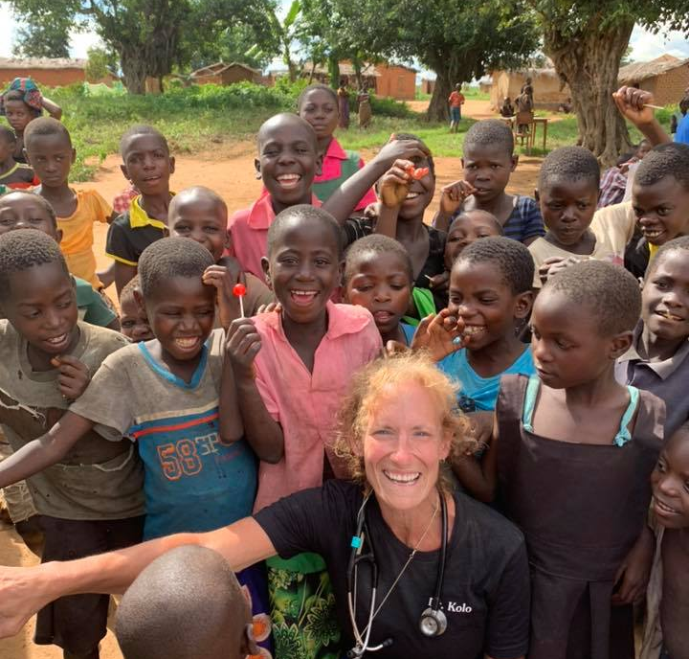
Rogue Humanitarians
(Dr Lucinda Kolo and team)
Notes:
- Fortunately, we had a dedicated team who came to Malawi all the way from the United states to help fight this injustice, by providing free and quality medical care to those who could not afford it

Slide 15
The Rotary Peace Fellowship
Notes:
Along the way, I was introduced to the Rotary Peace Fellowship by my boss at the hospital.
He thought with my work at the camp, I’d gain more knowledge and skills to effectively assist the refugees
I applied but I didn’t make it during the 1st attempt. I applied again the following year and I was selected for the fellowship

Slide 16
RPF Class 18
Notes:
I joined the RPF with the hope of returning home with the skill to do more than just seeing patients at the clinic.
- I wanted to study public health to prevent illnesses and peace and conflict resolution to provide me with the skill in Peacebuilding

Slide 17
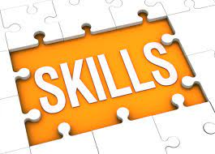
Notes:
I developed invaluable skills which I wouldn’t have developed without the fellowship.
I gained more than I expected

Slide 18
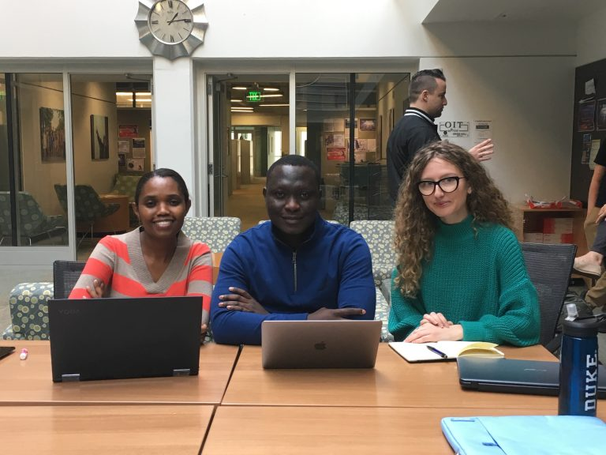
1. Interdisciplinary collaboration
Notes:
Due to the diverse background of classmates, I learnt how to collaborate on an interdisciplinary level to achieve a common goal
Our class was composed of fellows from diverse professional background
In this picture, we were working on a project that studied how refugees in the united states adapted to their new life in their communities.
We were of 3 different professional backgrounds- Medical Doctor, Economist and a lawyer

Slide 19
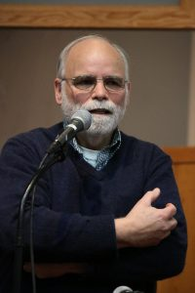
2. Advocacy
Notes:
I developed the skill to ameliorate the suffering and threats to human health through advocacy
During my applied field experience or internship, I had the opportunity to work with Chuck Root on a Global Grants application.
We focused on fighting disease by educating and equipping communities to stop the spread of life-threatening diseases.
The grant was approved and would help train village volunteers and health workers in critical areas.

Slide 20
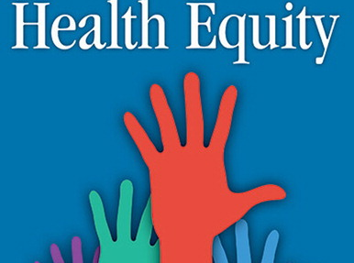
3. Health Equity Promotion
Master’s Paper on Menstrual Hygiene Management for displaced girls & women
Notes:
- I developed the skill to influence policy makers through my Masters project on promoting menstrual Hygiene management among displaced girls and women

Slide 21
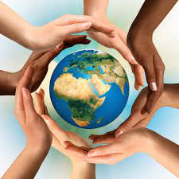
Future plans
Equal Access to health care
Refugee health
Effective implementation of health programs
MHM
Capacity building
Sustainability of our efforts
Good Steward Foundation
Notes:
Now that I’ve completed my studies, I plan to work on promoting equal access to health care
I plan to work among the refugees population by supporting effective implementation of health programs using the skills I developed in implementation science
As a start, I plan to support Menstrual Hygiene Management at the refugee camp
In addition, together with my husband, we’ve been looking into ways of reducing reliance on donations and making the assistance people receive sustainable
We then decided to form the Good Steward Foundation

Slide 22
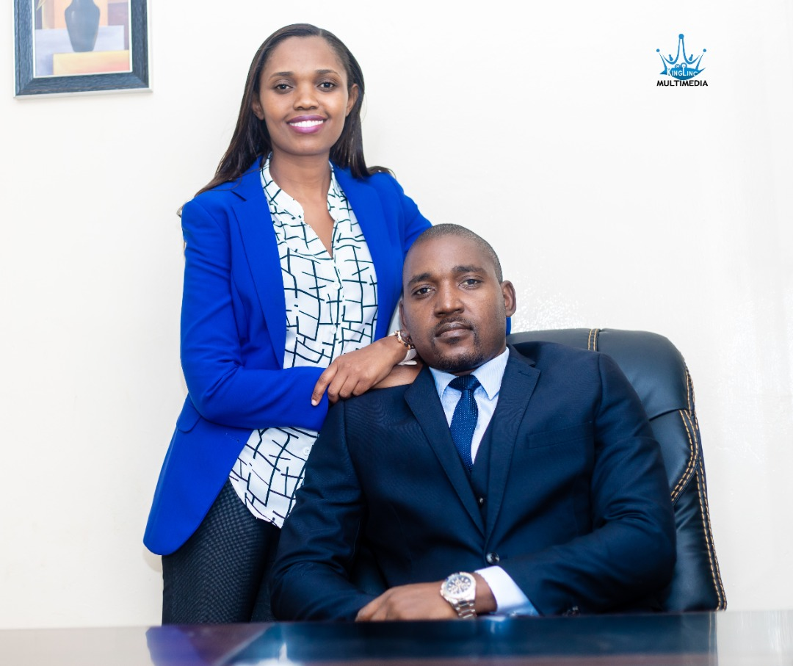
Good Steward Foundation
Objectives
To offer leadership and entrepreneurship mentorship to vulnerable children and young adults
To provide basic livelihood support, such as food, shelter and clothing, to vulnerable groups particularly children and the elderly;
To offer scholarships to children in need of educational support
Notes:
- We are in the process of registering the foundation and we hope to use the some of the proceeds from our family companies (Mvuma Group of Companies) to support our activities.
We hope to start all necessary activities by September this year and we welcome volunteers to work with us during this journey.
I also look forward to working with the VVT on the activities outlined during the Global Grants Application

Slide 23
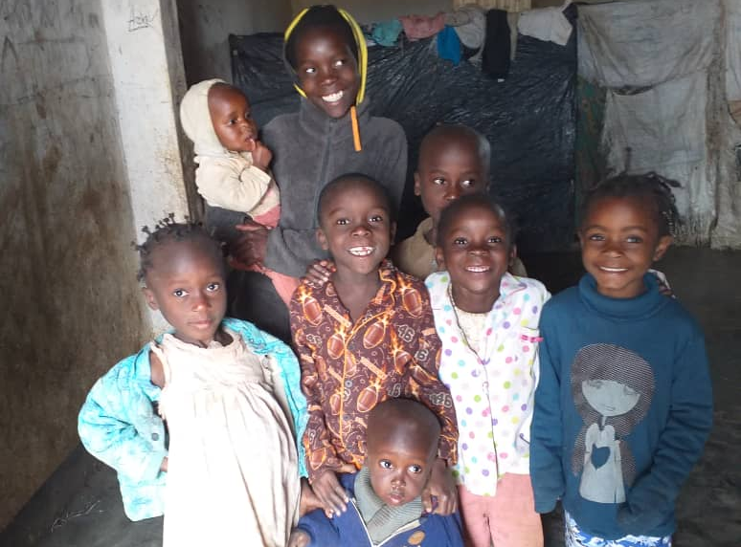
Notes:
I thank you for your attention.
If there are any questions, I’m glad to take them.

